Slide 1
WELCOME
ELA/Literacy

Slide 2
Session 1: Assessment Literacy Introduction

Slide 3
Session 1.A: Orientation and Purpose Setting

Slide 4
Purposes of This Training
Session 1.A: Orientation and Purpose Setting
Learn about performance assessments, how they provide robust evidence of student learning, and how they can support a balanced assessment system.
Collaboratively score student work from a Smarter Balanced performance task to build a common understanding of what student proficiency looks like.
Review student work as the basis for reflecting on and responding to the evidence of learning that performance tasks can generate.

Slide 5
Who Is in the Room?
Session 1.A: Orientation and Purpose Setting
Stand up if you are:
A classroom teacher
An instructional coach
A school-based administrator
A district administrator
Other

Slide 6
Note-Taking Guide
Session 1.A: Orientation and Purpose Setting
Separate handout
Session titles and objectives
Topics or activities
Space to write your comments and questions

Slide 7
Getting to Know You . . .
Session 1.A: Orientation and Purpose Setting
Choose one word or phrase that comes to mind when you think of student assessment.
Share your word with your table group, including why you selected it.
Write your word/phrase on a sticky note and bring your sticky note to the presenter.
Now discuss in pairs:
In what ways do you use assessment both for learning and of learning?

Slide 8
Session 1.B: Types of Assessment

Slide 9
Session 1.B and 1.C Objectives
Session 1.B: Types of Assessment
Develop a shared understanding of the intended purposes of different types of assessment within a balanced assessment system
Understand the role of performance assessment in providing robust evidence of student learning
Understand the role of performance assessment within the design of the Smarter Balanced Assessment System

Slide 10
Types of Assessment
Session 1.B: Types of Assessment
As we discuss three different types of assessment – formative, interim, and summative – use Handout 1.1 to capture your notes.
Think about how these different types of assessment work together to inform teaching and learning.

Slide 11
Formative Assessment
Session 1.B: Types of Assessment
Description:
“A process that takes place continuously during the course of teaching and learning to provide teachers and students with feedback to close the gap between current learning and desired goals.” — Margaret Heritage, Formative Assessment: Making It Happen in the Classroom. P.10
Not a tool or an event, but a process
Purposes:
Provide immediate or very rapid feedback to teachers and students
Provide evidence that can be used to adapt teaching and learning

Slide 12
Key Features of Formative Assessment:
Session 1.B: Types of Assessment
Clear lesson-learning goals and success criteria, so students understand what they are aiming for;
Evidence of learning gathered during lessons to determine where students are relative to goals;
A pedagogical response to evidence, including descriptive feedback, that supports learning by helping students answer: Where am I going? Where am I now? What are my next steps?
Peer- and self-assessment to strengthen students’ learning, efficacy, confidence, and autonomy;
A collaborative classroom culture where students and teachers are partners in learning.
(Linquanti, 2014)
From the CA ELA/ELD Framework
Notes:
Source: Linquanti, R. (2014). Supporting Formative Assessment for Deeper Learning: A Primer for Policymakers. Paper prepared for the Formative Assessment for Students and Teachers/State Collaborative on Assessment and Student Standards, 2. Washington, DC: Council of Chief State School Officers. Taken from the California ELA/ELD Framework, p. 823.

Slide 13
Formative Assessment
Session 1.B: Types of Assessment
Some ways to elicit evidence for formative assessment:
Observation of academic dialogue
Questioning discussions
Analysis of student work
Peer- and self-assessment strategies
What does formative assessment look like in your context?
Notes:
For other examples, please see CCSSO’s “Formative Assessment: Examples of Practice” document: http://www.csai-online.org/resources/formative-assessment-examples-practice.

Slide 14
Interim Assessment
Session 1.B: Types of Assessment
Description:
Compares student understanding or performance against a set of learning standards or objectives
May be administered at specified intervals over the course of an academic year
May be common across classes or schools
Purposes:
Monitor students’ academic progress toward longer-term goals
Inform school improvement planning
May predict a student’s end-of-year performance

Slide 15
Interim Assessment
Session 1.B: Types of Assessment
Examples of interim assessment:
Common interim assessments
Common performance tasks
Mid-term examinations
Trimester examinations
May include item banks
Notes:
For more information about interim assessment, please see CRESST’s “District Adoption and Implementation of Interim and Benchmark Assessments” report: http://www.csai-online.org/resource/68.

Slide 16
Summative Assessment
Session 1.B: Types of Assessment
Description:
May be referred to as a “culminating assessment”
Provides information on students’ knowledge and skills relative to learning standards
May be “high-stakes”
Purposes:
Provide an overall description of students’ learning status
Monitor and evaluate student achievement at the group level
Inform program-level and school-improvement planning

Slide 17
Summative Assessment
Session 1.B: Types of Assessment
Examples of large-scale summative assessment:
National Assessment of Educational Progress (NAEP)
Smarter Balanced Summative Assessments
Partnership for Assessment of Readiness for College and Careers (PARCC) Assessments
Specific statewide examinations
A summative assessment may also be given at the school or classroom level
End-of-unit assessment
End-of-course assessment
Notes:
For more information on state summative assessments, visit the CSAI site: http://www.csai-online.org/sos?t=assessment&m=.

Slide 18
Balanced Assessment Systems
Session 1.B: Types of Assessment
“A comprehensive, coherent, and continuous system of assessment provides mutually complementary views of student learning, ensures that assessment within each cycle is focused on the same ultimate goal—achievement of standards—and pushes instruction and learning in a common direction (Herman, 2010).”
California ELA/ELD Framework, P. 827
What do you think are key features of a balanced assessment system?

Slide 19
Balanced and Coherent Assessment System
Session 1.B: Types of Assessment
Importance for teaching and learning
Formative practices (teacher & student)
Summative
Interim
(Abedi & Linquanti, 2012; Linquanti, 2014)

Slide 20
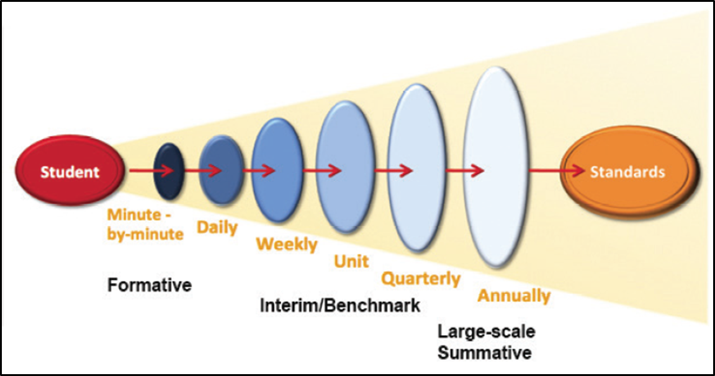
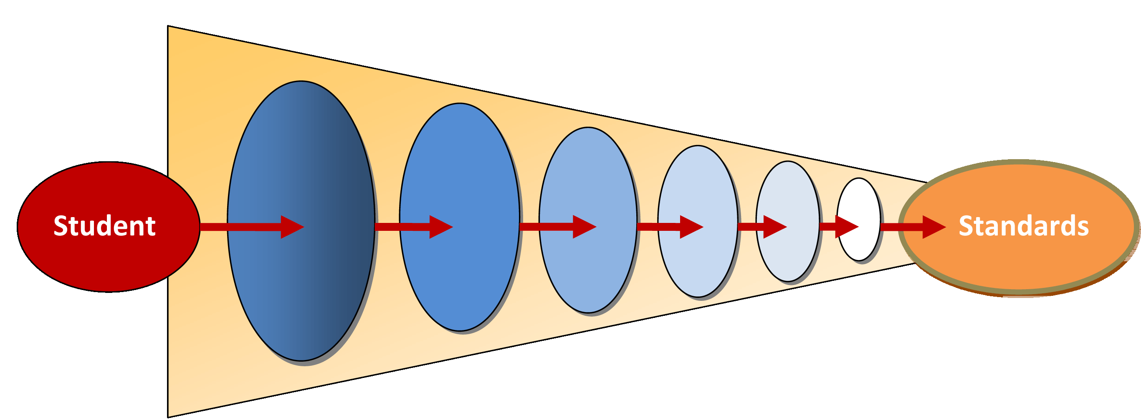
Assessment Cycles and Levels of Information
Session 1.B: Types of Assessment
“Grain size” of standards assessed
(CDE ELA/ELD Curriculum Framework, 2014 p. 826. Adapted from Herman & Heritage, 2007)
Statewide Summative
Classroom
Formative
Immediacy of actionable information
20

Slide 21
Session 1.B: Types of Assessment
How Does Assessment Support Teaching and Learning?
Take a moment to capture your thinking about how different assessments inform teaching and learning in Handout 1.1: Types of Assessment Organizer.
For reference, consider Handout 1.2: Types and Uses of Assessments within Assessment Cycles, and Handout 1.3: Overview of Major Assessment Types in Standards-Based Instruction.

Slide 22
Session 1.C: Performance Assessment

Slide 23
Item Types
Session 1.C: Performance Assessment
Different item types elicit different information about student learning from students and can be used for different purposes:
Selected response
Constructed response
Standardized performance tasks
Curriculum-embedded performance tasks

Slide 25
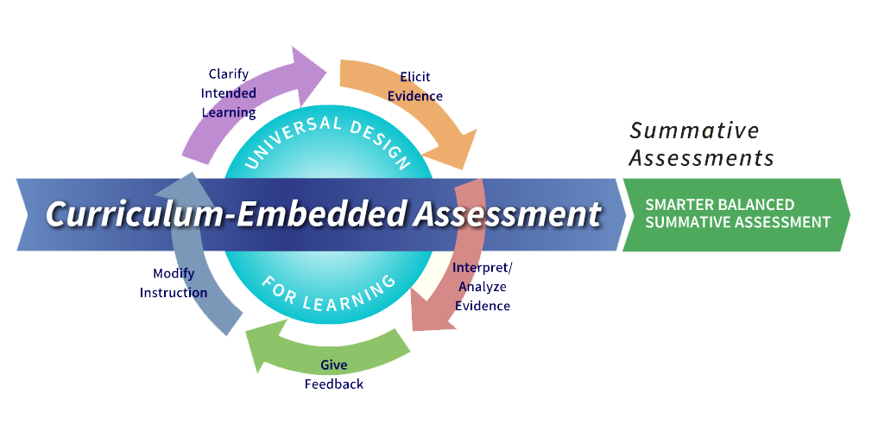
The Smarter Balanced Assessment System

Slide 26
Why Performance Tasks?
Session 1.C: Performance Assessment
READ: “Role of Smarter Balanced Performance Tasks” (Handout 1.4 in your booklet).
DO: Mark 2–3 most important words and/or phrases in the handout (highlight, underline, or circle).

Slide 27
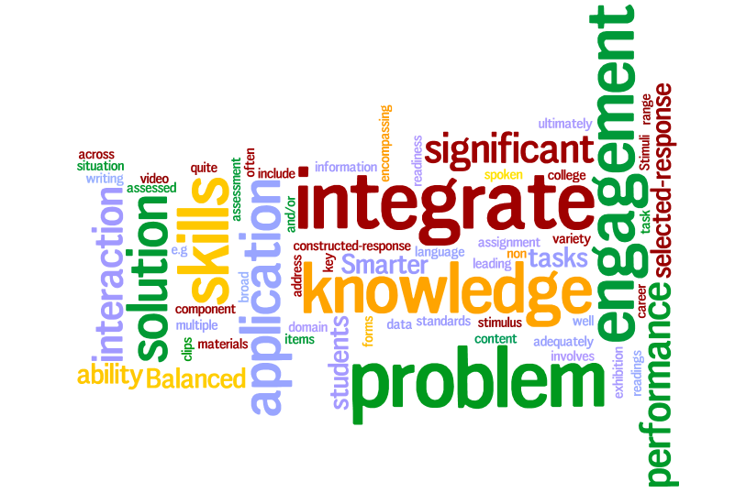
Session 1.C: Performance Assessment

Slide 28
Key Phrases
Session 1.C: Performance Assessment
Interaction with varied, rich stimuli
Engages students in a scenario
Solve a problem
Create a product with a specific purpose
Application of knowledge and skills
Integration . . . across multiple standards
Assesses what selected- and constructed-response items cannot

Slide 29
Reflect . . .
Session 1.C: Performance Assessment
Based on your analysis of the “Role of Smarter Balanced Performance Tasks” document, why is Smarter Balanced using performance tasks in its summative and interim assessments?

Slide 30
Four Principles of Performance Assessment
Session 1.C: Performance Assessment
. . . targets skills and knowledge that matter
. . . is assessment for and as learning
. . . is learning by doing
. . . links curriculum, instruction, and assessment

Slide 31
Session 2: Deep Dive into a Smarter Balanced Performance Task

Slide 32
Session 2 Objectives
Session 2: Deep Dive into a Smarter Balanced Performance Task
Experience a Smarter Balanced performance task from the perspective of a student, and unpack what the task requires students to know and be able to do
Understand Smarter Balanced performance task design and scoring tools
Collaboratively score student work from a Smarter Balanced performance task to build a common understanding of what student proficiency looks like
Analyze student work and consider the implications for teaching and learning

Slide 33
Session 2.A: Experiencing and Unpacking a Task

Slide 34
What Does a Smarter Balanced Performance Task Look Like?
Session 2.A: Experiencing and Unpacking a Task

Slide 35
Experience a Task
Session 2.A: Experiencing and Unpacking a Task
Work your way through all parts of the task, following instructions and responding to prompts as though you were a student.
When you reach the full write, develop a thesis statement and an outline for writing, rather than a full response.
Elementary group:
Handout 2.1—Grade 5 ELA Performance Task
Secondary group:
Handout 2.2—Grade 8 ELA Performance Task

Slide 36
Table Discussion and Activity
Session 2.A: Experiencing and Unpacking a Task
What do students need to know and be able to do to successfully complete this task?
With your table group, use chart paper to brainstorm a list.

Slide 37
Whole-Group Discussion
Session 2.A: Experiencing and Unpacking a Task
Prompts:
What are the knowledge and skill demands of this task for students?
What are the potential barriers for special populations and other students?
What strategies did you use to work your way through the task in the limited time we had?

Slide 38
Session 2.B: Claims and Targets

Slide 39
Claims and Targets Resource
Session 2.B: Claims and Targets
ELA Content Specifications, Appendix B

Slide 40
What Are Claims and Targets?
Session 2.B: Claims and Targets
Claims are the broad statements of the assessment system’s learning outcomes. A claim is a statement of what students know and can do, based on the evidence they produce.
Within each claim are related assessment targets. The assessment targets describe the expectations of what will be assessed by the items and tasks within each claim.

Slide 41
Session 2.B: Claims and Targets
The overall claim for grades 3–8:
“Students can demonstrate progress toward college and career readiness in English language arts and literacy.”
The overall claim for grade 11:
“Students can demonstrate college and career readiness in English language arts and literacy.”

Slide 42
Claims, Targets, and Standards
Session 2.B: Claims and Targets

Slide 43
ELA Claim #1 (Reading)
Session 2.B: Claims and Targets
Students can read closely and analytically to comprehend a range of increasingly complex literary and informational texts.

Slide 44
ELA Claim #2 (Writing)
Session 2.B: Claims and Targets
Students can produce effective and well-grounded writing for a range of purposes and audiences.

Slide 45
ELA Claim #3 (Speaking and Listening)
Session 2.B: Claims and Targets
Students can employ effective speaking and listening skills for a range of purposes and audiences.

Slide 46
ELA Claim #4 (Research/Inquiry)
Session 2.B: Claims and Targets
Students can engage in research and inquiry to investigate topics, and to analyze, integrate, and present information.

Slide 47
Important Things to Note
Session 2.B: Claims and Targets
There is only one claim and one assessment target associated with each item.
For SBAC Performance Tasks:
Research claim and targets are assessed in the constructed- and selected-response items.
Writing claim and targets are assessed in the full write (different targets are associated with different writing prompts).
Reading targets are not assessed.

Slide 48
Review Excerpt from Appendix B
Session 2.B: Claims and Targets
Elementary Group:
Handout 2.3—Elementary Excerpt from Appendix B
Focus on Grade 5, Writing Claim 2, Target 7
Secondary Group:
Handout 2.4—Secondary Excerpt from Appendix B
Focus on Grade 8, Writing Claim 2, Target 7

Slide 49
What do you notice?
Session 2.B: Claims and Targets
Consider the relationship between the claim, target, standards, and the full-write item on the performance task.
How effectively does the full-write item measure the claim, target, and standards?
How do you currently teach and assess these standards in your context?

Slide 50
Session 2.B: Claims and Targets
Questions about Claims and Targets?

Slide 51
Session 2.C: Introduction to the Writing Rubric

Slide 52
Context
Session 2.C: Introduction to the Writing Rubric
Smarter Balanced performance task writing rubrics have instructional implications for teachers at all grade levels (not just those listed on the individual rubrics).
We will focus on one of the Smarter Balanced performance task writing rubrics in this session.
The complete set is included in your Materials Booklet (Handout 2.18).

Slide 53
Rubric Review 1
Session 2.C: Introduction to the Writing Rubric
Individually, review the rubric associated with the performance task you experienced and unpacked in Session 2.A.
Elementary group:
Handout 2.5—Grades 3–5 Opinion Writing Rubric
Secondary group:
Handout 2.6—Grades 6–11 Argumentative Writing Rubric
Before you begin, please share: How familiar are you with this rubric already?

Slide 54
Rubric Review 2
Session 2.C: Introduction to the Writing Rubric
In your table groups, discuss your collective observations about:
Features of writing that are assessed
Structure of the rubric
Score levels
Rubric language

Slide 55
Key Features of the Rubric
Session 2.C: Introduction to the Writing Rubric
Analytic—three dimensions
Organization/Purpose
Evidence/Elaboration
Conventions
Four score levels + NS (Not Scorable)
Conventions excluded
Total point value: 10

Slide 56
Key Attributes of Writing That Are Assessed
Session 2.C: Introduction to the Writing Rubric
Organization/Purpose
Clear opinion/argument, focus
Use of transitional strategies to clarify relationships among ideas
Introduction and conclusion
Progression of ideas and connections among ideas
Sense of unity/completeness (Level 4)
Completeness/coherence (Level 3)
Loosely connected/somewhat sustained (Level 2)

Slide 57
Key Attributes of Writing That Are Assessed
Session 2.C: Introduction to the Writing Rubric
Evidence/Elaboration
Integration of relevant evidence from sources (facts, details)
Citation or attribution of sources
Elaborative techniques (e.g., specific examples, definitions, explanations, personal experiences)
Appropriate vocabulary/style
Thorough elaboration; effective development (Level 4)
Adequate elaboration and development (Level 3)
Uneven, cursory elaboration and development (Level 2)

Slide 58
Key Attributes of Writing That Are Assessed
Session 2.C: Introduction to the Writing Rubric
Conventions
Sentence formation
Punctuation
Capitalization
Grammar usage
Spelling
Three score levels (2, 1, 0)
Adequate command
Partial command
Little or no command

Slide 59
Rubric Adjectives Refer to Handout 2.7
Session 2.C: Introduction to the Writing Rubric
4
3
2
1
Clear,
Consistent,
Effective,
Logical,
Strong,
Appropriate, Comprehensive,
Specific
Clear,
Adequate,
General,
Generally appropriate
Somewhat unclear, Insufficient, Inconsistent, Weak,
Uneven, Somewhat ineffective, Imprecise,
Vague,
Repetitive
Confusing, Ambiguous,
Brief,
Few or no, Missing, Extraneous, Unclear,
Minimal, Irrelevant, Absent,
Incorrect,
Copied, Ineffective, Limited, Infrequent

Slide 60
NS—Not Scorable
Session 2.C: Introduction to the Writing Rubric
Insufficient (includes copied text)
In a language other than English
Off-topic
Off-purpose

Slide 61
Session 2.C: Introduction to the Writing Rubric
Questions about the writing rubric?

Slide 62
Session 2.D: Gathering Evidence and Scoring

Slide 63
Video
Session 2.D: Gathering Evidence and Scoring
Elementary group:
Video 2.1: ELA Hand Scoring – Elementary
Secondary group:
Video 2.2: ELA Hand Scoring – Secondary
Note: The video references a different task than the one you experienced/unpacked and a different writing rubric. Focus on the video’s description of the process for gathering evidence and scoring.

Slide 64
Step 1
Session 2.D: Gathering Evidence and Scoring
Review the Full-Write Prompt
Elementary group:
Handout 2.1—Grade 5 ELA Performance Task
Secondary group:
Handout 2.2—Grade 8 ELA Performance Task

Slide 65
Step 2
Session 2.D: Gathering Evidence and Scoring
Review the Writing Rubric
Elementary group:
Handout 2.5—Grades 3–5 Opinion Writing Rubric
Secondary group:
Handout 2.6—Grades 6–11 Argumentative Writing Rubric

Slide 66
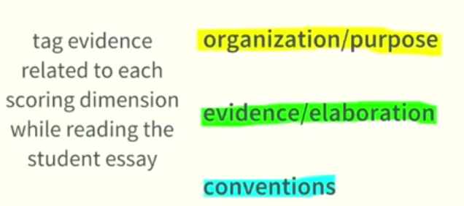
Step 3
Session 2.D: Gathering Evidence and Scoring
Individually Read and Score

Slide 67
Step 3, continued…
Session 2.D: Gathering Evidence and Scoring
After you tag pieces of evidence in student essays (or as you do so), mark the indicators within the rubric that are supported by the evidence.
Look for a preponderance of evidence.

Slide 68
Session 2.D: Gathering Evidence and Scoring
Questions about the scoring process?

Slide 69
Session 2.E: Review of the Scoring Process with Anchor Papers

Slide 70
Anchor Papers
Session 2.E: Review of the Scoring Process with Anchor Papers
Examples of student work that exemplify the attributes of a certain score level and that serve as a standard against which other papers or performances can be judged

Slide 71
Sample A
Session 2.E: Review of the Scoring Process with Anchor Papers
Elementary group:
Handout 2.8—Elementary Student Sample A
Secondary group:
Handout 2.9—Secondary Student Sample A
Read the Student Response
Review the scoring rationales and highlighted rubric for each dimension
Notes:
Note: all the student samples used in this session are posted on the Understanding Proficiency website (http://understandingproficiency.wested.org/) and use a Smarter Balanced performance tasks from the Practice Test. They can be shared publicly. Additional samples can be found on the website.

Slide 72
Discuss with your table group:
Session 2.E: Review of the Scoring Process with Anchor Papers
What seem to be the criteria for the dimensional scores associated with this response?
How does reviewing this sample help clarify your understanding of the rubric language?
How does reviewing this sample help anchor your understanding of the score levels for this rubric?

Slide 73
Sample B
Session 2.E: Review of the Scoring Process with Anchor Papers
Elementary group:
Handout 2.10—Elementary Student Sample B
Secondary group:
Handout 2.11—Secondary Student Sample B
Read the Student Response
Review the scoring rationales and highlighted rubric for each dimension

Slide 74
Session 2.F: Score and Discuss Two Samples

Slide 75
Individual Practice and Discussion
Session 2.F: Score and Discuss Two Samples
First, you’ll read and score Samples C and D individually.
Then each table will…
Chart their scores.
Discuss with the goal of coming to consensus on the scores.

Slide 76
Write Your Scores on Sticky Notes
Session 2.F: Score and Discuss Two Samples
e.g.,
“Gr3 Opinion B”
2
3
1

Slide 77
How Do You Chart Your Scores?
Session 2.F: Score and Discuss Two Samples
Charting Paper for
Sample
___
Dimension/
4
3
2
1
0
Score
Organization/
///
///
Purpose
Evidence/
////
/
/
Elaboration
Conventions
//////

Slide 78
Elect a Table Leader
Session 2.F: Score and Discuss Two Samples
Responsibilities:
Keep the group on track and focused.
Chart scores.
Ensure that all voices are heard.
Help bring the group to consensus.

Slide 79
Individual Scoring
Session 2.F: Score and Discuss Two Samples
Elementary group:
Handout 2.12—Elementary Student Samples C and D
Secondary group:
Handout 2.13—Secondary Student Samples C and D
Use the evidence-gathering and scoring process that was just modeled, using highlighters and blank rubrics provided.
Please respect your fellow participants–keep it quiet until the time is up!

Slide 80
Chart Your Scores
Session 2.F: Score and Discuss Two Samples
Dimension/ Score | 4 | 3 | 2 | 1 | 0
Organization/ Purpose
Evidence/ Elaboration
Conventions

Slide 81
Discuss Your Scores
Session 2.F: Score and Discuss Two Samples
Focusing on the samples and score dimensions in which there were more discrepancies within your group, try to come to consensus on each dimension score.
When explaining your scores, provide evidence and examples from the paper that support your selected score.
Remember: consensus may not be 100% agreement.
Sometimes it is okay to agree to disagree!
Don’t get stuck—discuss both samples.

Slide 82
Master Scores and Rationales
Session 2.F: Score and Discuss Two Samples
Elementary group:
Handout 2.14—Elementary Student Samples C and D with Rationales and Highlighted Rubrics
Secondary group:
Handout 2.15—Secondary Student Samples C and D with Rationales and Highlighted Rubrics
Compare your group’s consensus scores with the master scores

Slide 83
Session 2.F: Score and Discuss Two Samples
Questions about the master scores and rationales?

Slide 84
Session 2.G: Review of Full Scoring Guides and Other Writing Rubrics

Slide 85
Quick Review/Prime for Future Study
Session 2.G: Review of Full Scoring Guides and Other Writing Rubrics
Scan Two Resources
Full Scoring Guide for the Performance Task
Take note of scoring criteria for research questions.
Full Set of SBAC Performance Task Writing Rubrics
Take note of key similarities/differences.

Slide 86
Note: Three Research Question Formats
Session 2.G: Review of Full Scoring Guides and Other Writing Rubrics
Short text (2 points)
Multiple choice (1 point)
Matching table (1 point)

Slide 87
Note: Writing Purposes for Grade Spans
Session 2.G: Review of Full Scoring Guides and Other Writing Rubrics
Opinion (Grades 3–5)
Informational (Grades 3–5)
Narrative (Grades 3–8)
Argumentative (Grades 6–11)
Explanatory (Grades 6–11)

Slide 88
Scoring Guide
Session 2.G: Review of Full Scoring Guides and Other Writing Rubrics
Elementary group:
Handout 2.16—Full Scoring Guide for the Grade 5 ELA Performance Task
Secondary group:
Handout 2.17—Full Scoring Guide for the Grade 8 ELA Performance Task

Slide 89
Writing Rubrics
Session 2.G: Review of Full Scoring Guides and Other Writing Rubrics
Both groups:
Handout 2.18—Smarter Balanced Performance Task Writing Rubrics

Slide 90
Session 2.G: Score and Discuss Two Samples
Questions about the scoring guides or rubrics?
Any burning questions from Session 2 overall?

Slide 91
Session 3: Learning from Student Work on Performance Tasks

Slide 92
Session 3 Objectives
Session 3: Learning from Student Work on Performance Tasks
Deepen understanding of the formative assessment process
Analyze evidence of student learning elicited by a rigorous performance task
Explore meaningful ways of responding to evidence of student learning
Plan for modifying instruction based on evidence of student learning

Slide 93
Session 3.A: Introduction

Slide 94
Reflect on the Task and Student Work
Session 3.A: Introduction
Consider the task and student work you reviewed earlier today:
If the responses you reviewed had been from your own students, where would you want to go in your own instruction?
What kinds of learning experiences and formative assessment opportunities would support students in being successful on tasks like this?
How are the student responses similar to evidence you are accustomed to seeing in student work in your context?

Slide 95
Assessment in the Classroom
Session 3.A: Introduction

Slide 96
Session 3.B: Analyzing Student Work

Slide 97
Session 3.B Objectives
Session 3.B: Analyzing Evidence
Deepen understanding of formative assessment by analyzing and interpreting student work elicited by a performance task.
Find and read additional student work samples:
Elementary: Handout 3.1
Secondary: Handout 3.2

Slide 98
Review student work for formative purposes
Session 3.B: Analyzing Evidence
Use Handout 3.3: Student Work Analysis Organizer to help guide your review.
What strengths and challenges can you identify?
What gaps in skills or content knowledge might cause these challenges?
How might these challenges be addressed?

Slide 99
Session 3.C: Giving Feedback

Slide 100
Session 3.C Objective
Session 3.C: Giving Feedback
Deepen understanding of formative assessment by planning and providing feedback that can move student learning forward

Slide 101
A Thought Experiment on Feedback
Session 3.C: Giving Feedback
Find Handout 3.4: Receiving Feedback and turn to the page with your assigned number.
Imagine this is your own essay as you read through the feedback.
How does this feedback on your paper make you feel?
How motivated are you to improve this essay?
What does the feedback tell you about how to improve your writing?
What questions do you have for the teacher?

Slide 102
Effective Feedback
Session 3.C: Giving Feedback
Where am I going?
Where am I now?
Where to next?
(Heritage, 2010)
Notes:
Source: Heritage, M., & Stigler, J. W. (2010). Formative assessment: Making it happen in the classroom. Thousand Oaks, Calif: Corwin. P. 80.

Slide 103
Focus of Formative Feedback:
Session 3.C: Giving Feedback
Providing information to the student with the goal of closing the gap between current learning and learning goals
Guiding the student to adjust and revise their thinking and to understand their own next steps
Providing criterion-based, clear and motivational information

Slide 104
Qualities of Effective Feedback
Session 3.C: Giving Feedback
What adjectives would you use to describe effective formative feedback in your context?
Individually, write three descriptive words on a sticky note.
Share your words with your table group.

Slide 105
Modes of Feedback
Session 3.C: Giving Feedback
What strategies or structures do you use to give students feedback?

Slide 106
Practice – Planning Feedback Strategies
Session 3.C: Giving Feedback
Return to your notes in Handout 3.3. With a partner, consider these questions:
Keeping in mind the qualities and modes of feedback we just discussed, how would you provide feedback to support these student(s) in moving their own learning forward?
Why did you make these choices?

Slide 107
Practice – Planning Feedback Conversations
Session 3.C: Giving Feedback
With a partner, identify one student sample or a pattern seen across the samples to which you would like to respond.
Plan a student conference (for individual sample) or a group discussion (for a pattern) that could help move student learning forward.
Plan an evidence-based discussion you would have with the student.
Develop three good questions you would ask the student.
You will enact and debrief your feedback with a partner.

Slide 108
Enacting Feedback
Session 3.C: Giving Feedback
Find a new partner and enact your conversation as a teacher, with your partner playing the role of the student. (5 minutes)
Debrief your conversation – What worked well? What questions and suggestions do you have? (2 minutes)
Switch partners and enact and debrief a second conversation.

Slide 109
Feedback
Session 3.C: Giving Feedback
What worked well?
What was challenging?
What are your takeaways about feedback?

Slide 110
Session 3.D: Modifying Instruction

Slide 111
Session 3.D Objectives
Session 3.D: Modifying Instruction
Develop a shared definition of curriculum-embedded performance assessment
Based on your analysis of student samples, and the needs of students in your context, consider adaptations to the task you could make to support student learning in a classroom setting.

Slide 112
Defining “Curriculum-Embedded”
Session 3.D: Modifying Instruction
A curriculum-embedded performance task is fully integrated into a unit of study and provides students with ample instructional support.
Ideally, curriculum-embedded tasks require students to do and produce authentic work with the skills and knowledge contained in a given unit.

Slide 114
Adapting a Task for the Classroom
Session 3.D: Modifying Instruction
Return to your analysis of student work in Handout 3.3.
In your evaluation of student work samples from this earlier task, what skills and concepts were identified as the biggest challenges for students?
Are there other challenges that you anticipate for students in your own context?

Slide 115
Adapting a Task for the Classroom
Session 3.D: Modifying Instruction
Based on your analysis of student work, create a poster with your ideas for adapting this task to a classroom setting.
How could you scaffold student learning?
What opportunities for formative assessment could you plan?
How would you make the task more engaging

Slide 116
Gallery Walk
Session 3.D: Modifying Instruction
Circulate around the room, viewing the posters created by your colleagues.
Add sticky notes if you have any feedback or ideas.

Slide 117
Performance Assessment Resource Bank (PARB)
Session 3.D: Modifying Instruction
This website offers free, vetted K-12 curriculum-embedded performance tasks in math, English/language arts, science, and history/social studies:
www.performanceassessmentresourcebank.org

Slide 118
Session 3.D: Modifying Instruction
See Handout 3.5: Additional Resources for Performance Assessment for more information.

Slide 119
Closing Reflections
Session 3.D: Modifying Instruction
How has today’s experience impacted your thinking about performance assessment?

