Slide 1
Welcome
Mathematics

Slide 2
Session 1.A: Orientation and Purpose Setting

Slide 3
Purposes of This Training
Session 1.A: Orientation and Purpose Setting
Learn about performance assessments, how they provide robust evidence of student learning, and how they can support a balanced assessment system.
Collaboratively score student work from a Smarter Balanced performance task to build a common understanding of what student proficiency looks like.
Review student work as the basis for reflecting on and responding to the evidence of learning that performance tasks can generate.

Slide 4
Who Is in the Room?
Session 1.A: Orientation and Purpose Setting
Stand up if you are:
A classroom teacher
An instructional coach
A school-based administrator
A district administrator
Other

Slide 5
Note-Taking Guide
Session 1.A: Orientation and Purpose Setting
Separate handout
Session titles and objectives
Topics or activities
Space to write your comments and questions

Slide 6
Getting to Know You . . .
Session 1.A: Orientation and Purpose Setting
Choose one word or phrase that comes to mind when you think of student assessment.
Share your word with your table group, including why you selected it.
Write your word/phrase on a sticky note and bring your sticky note to the presenter.
Now discuss in pairs:
In what ways do you use assessment both for learning and of learning?

Slide 7
Session 1.B: Types of Assessment

Slide 8
Session 1.B and 1.C Objectives
Session 1.B: Types of Assessment
Develop a shared understanding of the intended purposes of different types of assessment within a balanced assessment system
Understand the role of performance assessment in providing robust evidence of student learning
Understand the role of performance assessment within the design of the Smarter Balanced Assessment System

Slide 9
Types of Assessment
Session 1.B: Types of Assessment
As we discuss three different types of assessment – formative, interim, and summative – use Handout 1.1 to capture your notes.
Think about how these different types of assessment work together to inform teaching and learning.

Slide 10
Formative Assessment
Session 1.B: Types of Assessment
Description:
“A process that takes place continuously during the course of teaching and learning to provide teachers and students with feedback to close the gap between current learning and desired goals.” — Margaret Heritage, Formative Assessment: Making It Happen in the Classroom. P.10
Not a tool or an event, but a process
Purposes:
Provide immediate or very rapid feedback to teachers and students
Provide evidence that can be used to adapt teaching and learning

Slide 11
Key Features of Formative Assessment:
Session 1.B: Types of Assessment
Clear lesson-learning goals and success criteria, so students understand what they are aiming for;
Evidence of learning gathered during lessons to determine where students are relative to goals;
A pedagogical response to evidence, including descriptive feedback, that supports learning by helping students answer: Where am I going? Where am I now? What are my next steps?
Peer- and self-assessment to strengthen students’ learning, efficacy, confidence, and autonomy;
A collaborative classroom culture where students and teachers are partners in learning.
(Linquanti, 2014)
From the CA ELA/ELD Framework
Notes:
Source: Linquanti, R. (2014). Supporting Formative Assessment for Deeper Learning: A Primer for Policymakers. Paper prepared for the Formative Assessment for Students and Teachers/State Collaborative on Assessment and Student Standards, 2. Washington, DC: Council of Chief State School Officers. Taken from the California ELA/ELD Framework, p. 823.

Slide 12
Formative Assessment
Session 1.B: Types of Assessment
Some ways to elicit evidence for formative assessment:
Observation of academic dialogue
Questioning discussions
Analysis of student work
Peer- and self-assessment strategies
What does formative assessment look like in your context?
Notes:
For other examples, please see CCSSO’s “Formative Assessment: Examples of Practice” document: http://www.csai-online.org/resources/formative-assessment-examples-practice.

Slide 13
Interim Assessment
Session 1.B: Types of Assessment
Description:
Compares student understanding or performance against a set of learning standards or objectives
May be administered at specified intervals over the course of an academic year
May be common across classes or schools
Purposes:
Monitor students’ academic progress toward longer-term goals
Inform school improvement planning
May predict a student’s end-of-year performance

Slide 14
Interim Assessment
Session 1.B: Types of Assessment
Examples of interim assessment:
Common interim assessments
Common performance tasks
Mid-term examinations
Trimester examinations
May include item banks
Notes:
For more information about interim assessment, please see CRESST’s “District Adoption and Implementation of Interim and Benchmark Assessments” report: http://www.csai-online.org/resource/68.

Slide 15
Summative Assessment
Session 1.B: Types of Assessment
Description:
May be referred to as a “culminating assessment”
Provides information on students’ knowledge and skills relative to learning standards
May be “high-stakes”
Purposes:
Provide an overall description of students’ learning status
Monitor and evaluate student achievement at the group level
Inform program-level and school-improvement planning

Slide 16
Summative Assessment
Session 1.B: Types of Assessment
Examples of large-scale summative assessment:
National Assessment of Educational Progress (NAEP)
Smarter Balanced Summative Assessments
Partnership for Assessment of Readiness for College and Careers (PARCC) Assessments
Specific statewide examinations
A summative assessment may also be given at the school or classroom level
End-of-unit assessment
End-of-course assessment
Notes:
For more information on state summative assessments, visit the CSAI site: http://www.csai-online.org/sos?t=assessment&m=.

Slide 17
Balanced Assessment Systems
Session 1.B: Types of Assessment
“A comprehensive, coherent, and continuous system of assessment provides mutually complementary views of student learning, ensures that assessment within each cycle is focused on the same ultimate goal—achievement of standards—and pushes instruction and learning in a common direction (Herman, 2010).”
California ELA/ELD Framework, P. 827
What do you think are key features of a balanced assessment system?

Slide 18
Balanced and Coherent Assessment System
Session 1.B: Types of Assessment
Importance for teaching and learning
Formative practices (teacher & student)
Summative
Interim
(Abedi & Linquanti, 2012; Linquanti, 2014)

Slide 19
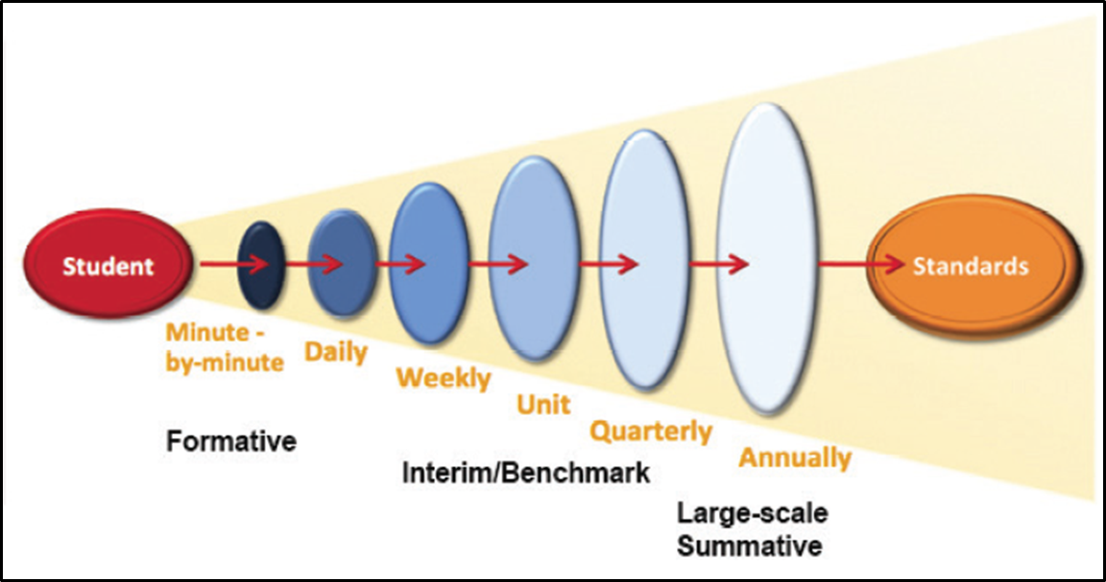
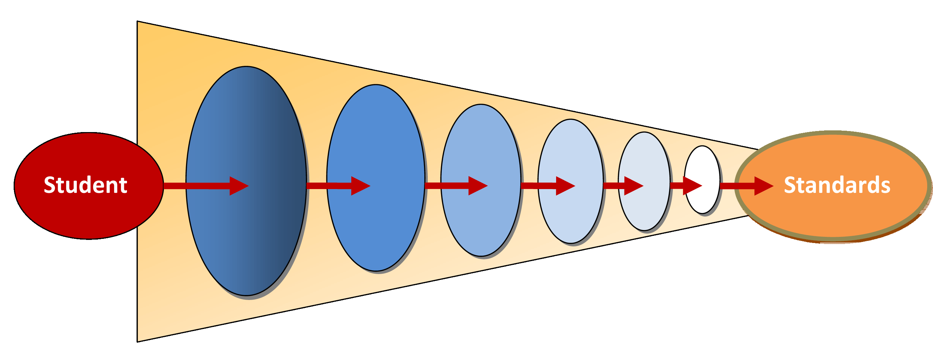
Assessment Cycles and Levels of Information
Session 1.B: Types of Assessment
“Grain size” of standards assessed
(CDE ELA/ELD Curriculum Framework, 2014 p. 826. Adapted from Herman & Heritage, 2007)
Statewide Summative
Classroom
Formative
Immediacy of actionable information
19

Slide 20
Session 1.B: Types of Assessment
How Does Assessment Support Teaching and Learning?
Take a moment to capture your thinking about how different assessments inform teaching and learning in Handout 1.1: Types of Assessment Organizer.
For reference, consider Handout 1.2: Types and Uses of Assessments within Assessment Cycles, and Handout 1.3: Overview of Major Assessment Types in Standards-Based Instruction.

Slide 21
Session 1.C: Performance Assessment

Slide 22
Item Types
Session 1.C: Performance Assessment
Different item types elicit different information about student learning from students and can be used for different purposes:
Selected response
Constructed response
Standardized performance tasks
Curriculum-embedded performance tasks

Slide 24
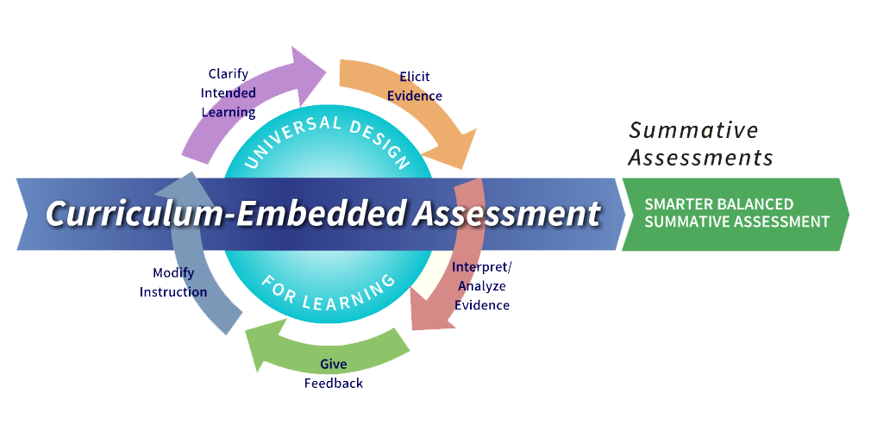
The Smarter Balanced Assessment System

Slide 25
Why Performance Tasks?
Session 1.C: Performance Assessment
READ: “Role of Smarter Balanced Performance Tasks” (Handout 1.4 in your booklet).
DO: Mark 2–3 most important words and/or phrases in the handout (highlight, underline, or circle).

Slide 26
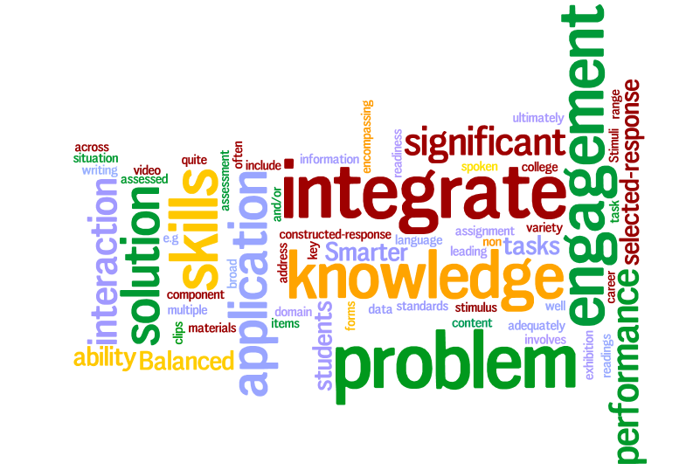
Session 1.C: Performance Assessment

Slide 27
Key Phrases
Session 1.C: Performance Assessment
Interaction with varied, rich stimuli
Engages students in a scenario
Solve a problem
Create a product with a specific purpose
Application of knowledge and skills
Integration . . . across multiple standards
Assesses what selected- and constructed-response items cannot

Slide 28
Reflect . . .
Session 1.C: Performance Assessment
Based on your analysis of the “Role of Smarter Balanced Performance Tasks” document, why is Smarter Balanced using performance tasks in its summative and interim assessments?

Slide 29
Four Principles of Performance Assessment
Session 1.C: Performance Assessment
. . . targets skills and knowledge that matter
. . . is assessment for and as learning
. . . is learning by doing
. . . links curriculum, instruction, and assessment

Slide 30
Session 2: Deep Dive into a Smarter Balanced Performance Task

Slide 31
Session 2 Objectives
Understand the design of a standardized math performance task and scoring tools
Experience a performance task from the perspective of a student and unpack its learning demands and assessment purposes
Collaboratively analyze student work and consider the implications for teaching and learning

Slide 32
Let’s Get to Know a Performance Task

Slide 33
Session 2A: Getting to Know the Task
Individually Complete
a Performance Task
Grade 5: Clay Pottery
Pages 62-64

Slide 34
Initial Reactions
Session 2A: Getting to Know the Task
At your table, discuss your experience with the task.
What did you notice?
What questions arose?
What surprised you?

Slide 35
Identifying the Math and Anticipating Issues
Session 2A: Getting to Know the Task
What do students need to know and be able to do to accomplish the task?
What would you expect your own students to struggle with in this task?
Use Handout 2.1 to make some notes (pg. 7).

Slide 36
Session 2 Progress
2A Getting to Know the Task
2C Analyzing Student Work
Complete performance task
Initial reactions to the task
Identify the mathematics and anticipate the issues
Read student responses to first item
Review and discuss Scoring Guide for first item
Score student responses to item
Compare and discuss scores for item
Repeat the steps of scoring with next hand-scored item(s)
2D Debriefing the Task
2B Unpacking the Task
Alignment activity

Slide 37
Let’s Unpack This Task

Slide 38
As we unpack the task, we will:
Session 2B: Unpacking the Task
Understand the Smarter Balanced Claims
Align the task
Reflect on the purpose of performance tasks

Slide 39
Let’s consider what this task assesses:
Session 2B: Unpacking the Task
CCSS Standards for Mathematical Practice likely to be engaged by students working on this task
Smarter Balanced Claims assessed by this task

Slide 40
Standards for Mathematical Practice
Session 2B: Unpacking the Task
Make sense of problems and persevere in solving them.
Reason abstractly and quantitatively.
Construct viable arguments and critique the reasoning of others.
Model with mathematics.
Use appropriate tools strategically.
Attend to precision.
Look for and make use of structure.
Look for and express regularity in repeated reasoning.

Slide 41
What are Claims and Targets?
Session 2B: Unpacking the Task
Claims are the broad statements of the assessment system’s learning outcomes. A claim is a statement of what students know and can do, based on the evidence they produce.
Within each claim are related assessment targets. The assessment targets describe the expectations of what will be assessed by the items and tasks within each claim.

Slide 42
Overall Smarter Balanced Claims
Session 2B: Unpacking the Task
Grades 3–8
Students can demonstrate progress toward college and career readiness in mathematics.
Grade 11
Students can demonstrate college and career readiness in mathematics.

Slide 43
Session 2B: Unpacking the Task
Claim 1: Concepts and Procedures
Students can explain and apply mathematical concepts and carry out mathematical procedures with precision and fluency.
Claim 3: Communicating Reasoning
Students can clearly and precisely construct viable arguments to support their own reasoning and to critique the reasoning of others.
Claim 4: Data Analysis and Modeling
Students can analyze complex, real-world scenarios and can construct and use mathematical models to interpret and solve problems.
Claim 2: Problem Solving
Students can frame and solve a range of complex well-posed problems in pure and applied mathematics, making productive use of knowledge and problem solving strategies.

Slide 44
Focus for Performance Tasks
Session 2B: Unpacking the Task
Claim 1: Concepts and Procedures
Evidence of Claim 1 shows that students can “do math.”
Claim 2: Problem Solving
Evidence of Claims 2, 3, and 4 show that students can apply mathematics to novel situations, think and reason mathematically, and use math to analyze empirical situations, understand situations better, and improve decisions.
Claim 3: Communicating Reasoning
Claim 4: Data Analysis and Modeling

Slide 45
Aligning the Task
Session 2B: Unpacking the Task
Use the Smarter Balanced Claims and Practices cards to indicate on Handout 2.3 (pg. 10):
Which of the CCSS Standards for Mathematical Practice are likely to be engaged in this task?
Which of the Smarter Balanced Claims are assessed by this task?

Slide 46
Reflection on the purpose of performance tasks on a summative assessment
Session 2B: Unpacking the Task
What skills and abilities can be assessed by performance tasks that are hard to assess with other assessment types?
What skills and abilities do you currently focus on in your own instructional practice, and which would you like to focus on more?

Slide 47
Let’s Look at How Students Handled This Task

Slide 48
As you look at student responses . . .
Session 2C: Analyzing Student Work
Keep an eye out for:
Successful approaches
Examples of good explanations
Common errors/misconceptions
Use Handout 2.4 (pg. 11) to make notes.

Slide 49
Individually review student responses to the first hand-scored item. Begin to make some notes on the Analyzing Student Work handout.
Session 2C: Analyzing Student Work

Slide 50
Review and discuss Scoring Guide for first item.
Session 2C: Analyzing Student Work

Slide 51
Individually score student responses to this item. When finished, please quietly record notes on the Analyzing Student Work handout.
Session 2C: Analyzing Student Work

Slide 52
Compare and discuss scores. Review score rationales.
Session 2C: Analyzing Student Work

Slide 53
Session 2 Progress
2A Getting to Know the Task
2C Analyzing Student Work
Complete performance task
Share initial reactions to task
Identify the mathematics and anticipate the issues
Read student responses to first item
Review and discuss Scoring Guide for first item
Score student responses to item
Compare and discuss scores for item
Repeat the steps of scoring with next hand-scored item(s)
2D Debriefing the Task
2B Unpacking the Task
Alignment activity

Slide 54
Individually review student responses to the next hand-scored item. Continue making notes on the Analyzing Student Work handout.
Session 2C: Analyzing Student Work

Slide 55
Review and discuss Scoring Guide for next item.
Session 2C: Analyzing Student Work

Slide 56
Individually score student responses.
Session 2C: Analyzing Student Work

Slide 57
Compare scores. Discuss discrepancies.
Session 2C: Analyzing Student Work

Slide 58
Before we look at responses to the final item, reflect on the demands of this item.
Session 2C: Analyzing Student Work
What do students need to know and be able to do in order to produce a strong response to this item? (Refer to your notes on Handout 2.1.)
Once you begin looking at the student work, add to your notes on Handout 2.4.

Slide 59
Individually review student responses to the next hand-scored item. Continue making notes on the Analyzing Student Work handout.
Session 2C: Analyzing Student Work

Slide 60
Review and discuss Scoring Guide for next item.
Session 2C: Analyzing Student Work

Slide 61
Individually score student responses.
Session 2C: Analyzing Student Work
Notes:
=

Slide 62
Compare scores. Discuss discrepancies.
Session 2C: Analyzing Student Work
Notes:
=

Slide 63
Session 2 Progress
2A Getting to Know the Task
2C Analyzing Student Work
Complete performance task
Share initial reactions to task
Identify the mathematics and anticipate the issues
Read student responses to first item
Review and discuss Scoring Guide for first item
Score student responses to item
Compare and discuss scores for item
Repeat the steps of scoring with next hand-scored item(s)
2D Debriefing the Task
2B Unpacking the Task
Alignment activity

Slide 64
Let’s Debrief the Task

Slide 65
What can we learn from analyzing responses to this task?
Session 2D: Debriefing the Task
Successful approaches
Examples of good explanations
Common errors/misconceptions

Slide 66
Reflecting back and thinking ahead
Session 2D: Debriefing the Task
What are the knowledge and skill demands of this task for students?
What are potential barriers for your own students?
What strategies and math practices are your own students accustomed to using with performance tasks?

Slide 67
Reflect on the Task and Student Work
Session 2: Learning from Student Work on Performance Tasks
Consider the task and student work you reviewed earlier today:
If the responses you reviewed had been from your own students, where would you want to go in your own instruction?
What kinds of learning experiences and formative assessment opportunities would support students in moving learning forward?
How are the student responses similar to evidence you are accustomed to seeing in your own students’ work?

Slide 68
Session 3: Learning from Student Work on Performance Tasks

Slide 69
Session 3 Objectives
Deepen understanding of the formative assessment process
Analyze evidence of student learning elicited by a performance task
Explore meaningful ways of responding to evidence of student learning
Plan for modifying instruction based on evidence of student learning

Slide 70
Let’s Get to Know Another Performance Task

Slide 71
Individually Complete a Performance Task
Session 3A: Getting to Know the Task
Grade 4: Art Day!
Grade 7: Let’s Paint a Room

Slide 72
Initial Reactions
Session 3A: Getting to Know the Task
At your table, discuss your experience with the task.
What did you notice?
What questions arose?
What surprised you?

Slide 73
Identifying the Math and Anticipating Issues
Session 3A: Getting to Know the Task
What do students need to know and be able to do to accomplish the task?
What would you expect your own students to struggle with in this task?
Use Handout 3.1 to make some notes.

Slide 74
Session 3 Progress
3A Getting to Know the Task
3C Developing Feedback
Complete performance task
Share initial reactions to task
Identify the mathematics and anticipate the issues
Describe patterns evident in student responses and identify which responses fit each pattern
For each pattern, develop feedback comments and questions
3B Analyzing Student Work
3D Modifying Instruction
Read student responses to first item
Review Scoring Guide, scores, and score rationales for this item
Share and discuss patterns in student responses to this item
Repeat the steps of analysis with next hand-scored item(s)
Explore examples of curriculum-embedded performance tasks
Reflect on what instructional decisions might be made in response to evidence of student learning
Plan curriculum-embedded performance task for your own context
Share additional resources

Slide 75
Let’s Look at How Students Handled This Task

Slide 76
As you look at student responses . . .
Session 3B: Analyzing Student Work
What did each student do successfully?
What misconceptions are evident?
What feedback might be helpful?
Use Handout 3.2 to make notes.

Slide 77
Individually review student responses to the first hand-scored item. Begin to make some notes on the Analyzing Student Work handout.
Session 3B: Analyzing Student Work

Slide 78
Review and discuss Scoring Guide, scores, and score rationales for this item.
Session 3B: Analyzing Student Work

Slide 79
What did each student do successfully? What misconceptions are evident? What feedback might be helpful?
Session 3B: Analyzing Student Work
Discuss patterns in responses to this item.

Slide 80
Session 3 Progress
3A Getting to Know the Task
3C Developing Feedback
Complete performance task
Share initial reactions to task
Identify the mathematics and anticipate the issues
Describe patterns evident in student responses and identify which responses fit each pattern
For each pattern, develop feedback comments and questions
3B Analyzing Student Work
3D Modifying Instruction
Read student responses to first item
Review Scoring Guide, scores, and score rationales for this item
Share and discuss patterns in student responses to this item
Repeat the steps of analysis with next hand-scored item(s)
Explore examples of curriculum-embedded performance tasks
Reflect on what instructional decisions might be made in response to evidence of student learning
Plan curriculum-embedded performance task for your own context
Share additional resources

Slide 81
Individually review student responses to the next hand-scored item. Add to your notes on the Analyzing Student Work handout.
Session 3B: Analyzing Student Work

Slide 82
Review and discuss Scoring Guide, scores, and score rationales for this item.
Session 3B: Analyzing Student Work

Slide 83
What did each student do successfully? What misconceptions are evident? What feedback might be helpful?
Session 3B: Analyzing Student Work
Discuss patterns in responses to this item.

Slide 84
Before we look at responses to the final item, reflect on the demands of this item.
Session 3B: Analyzing Student Work
What do students need to know and be able to do in order to produce a strong response to this item? (Refer to your notes on Handout 3.1.)
Once you begin looking at the student work, add to your notes on Handout 3.2.

Slide 85
Individually review student responses to the next hand-scored item. Add to your notes on the Analyzing Student Work handout.
Session 3B: Analyzing Student Work

Slide 86
Review and discuss Scoring Guide, scores, and score rationales for this item.
Session 3B: Analyzing Student Work

Slide 87
What did each student do successfully? What misconceptions are evident? What feedback might be helpful?
Session 3B: Analyzing Student Work
Discuss patterns in responses to this item.

Slide 88
Session 3 Progress
3A Getting to Know the Task
3C Developing Feedback
Complete performance task
Share initial reactions to task
Identify the mathematics and anticipate the issues
Describe patterns evident in student responses and identify which responses fit each pattern
For each pattern, develop feedback comments and questions
3B Analyzing Student Work
3D Modifying Instruction
Read student responses to first item
Review Scoring Guide, scores, and score rationales for this item
Share and discuss patterns in student responses to this item
Repeat the steps of analysis with next hand-scored item(s)
Explore examples of curriculum-embedded performance tasks
Reflect on what instructional decisions might be made in response to evidence of student learning
Plan curriculum-embedded performance task for your own context
Share additional resources

Slide 89
Next we’ll consider:
Session 3C: Developing Feedback
What kind of feedback or probing questions would help students move their learning forward?

Slide 90
Preparing to develop feedback
Session 3C: Developing Feedback
What, specifically, are we looking for in the student work?
Review your notes on the Analyzing Student Work handout through the lens of the mathematical practices.
Discuss with a partner when and how the math practices are relevant.

Slide 91
Group Work
Session 3C: Developing Feedback
All groups will focus on responses to Item 3.
Each group will be assigned either MP 1, 2, 3, or 4.
All groups will consider MP 6.
Use the table on page 14 to identify which student responses provide:
Evidence that the student successfully utilizes the MP
Evidence that the student needs more experience engaging this MP.

Slide 92
Developing Feedback
Session 3C: Developing Feedback
Each group will create a poster to brainstorm feedback questions that encourage and strengthen one or more of the math practices.
The feedback should be based on specific evidence.
Be prepared to share your ideas with the whole group.

Slide 93
Summarize and Capture Ideas:
Session 3C: Developing Feedback
Each group presents their draft feedback ideas to the whole group for reaction and ideas for refinement.
Use the table on page 15 to capture the feedback questions for each math practice.

Slide 94
Our challenge:
Session 3C: Developing Feedback
Agree on a short list of 2-3 feedback questions or comments to share with these students.

Slide 95
Our feedback for this class
Session 3C: Developing Feedback
Feedback comment: Your work shows evidence that you understand quite a bit about…
Feedback question 1:
Feedback question 2:
Feedback question 3:

Slide 96
Reflection
Session 3D: Modifying Instruction – Performance Tasks in the Classroom
Consider the task, student work and feedback for this performance task.
What kinds of learning experiences and formative assessment opportunities would support these students, based on the patterns evident in their work?

Slide 97
Framing Question
Session 3D: Modifying Instruction – Performance Tasks in the Classroom
How can we use performance tasks to formatively assess what students are learning in our classrooms . . .
. . . in other words, to formatively assess our own instruction?

Slide 98
Reflecting back and thinking ahead
Session 3D: Modifying Instruction – Performance Tasks in the Classroom
What are the knowledge and skill demands of this task for students?
What are potential barriers for your own students?
What strategies and math practices are your own students accustomed to using with performance tasks?

Slide 99
Session 3 Progress
3A Getting to Know the Task
3C Developing Feedback
Complete performance task
Share initial reactions to task
Identify the mathematics and anticipate the issues
Describe patterns evident in student responses and identify which responses fit each pattern
For each pattern, develop feedback comments and questions
3B Analyzing Student Work
3D Modifying Instruction
Read student responses to first item
Review Scoring Guide, scores, and score rationales for this item
Share and discuss patterns in student responses to this item
Repeat the steps of analysis with next hand-scored item(s)
Explore examples of curriculum-embedded performance tasks
Reflect on what instructional decisions might be made in response to evidence of student learning
Plan curriculum-embedded performance task for your own context
Share additional resources

Slide 100
Assessment in the Classroom
Session 3D: Modifying Instruction – Performance Tasks in the Classroom

Slide 101
Modifying Instruction – Our Objectives
Session 3D: Modifying Instruction – Performance Tasks in the Classroom
Develop a shared definition of curriculum-embedded performance assessment.
Based on your analysis of student samples, and the needs of students in your context, consider adaptations to the task you could make to support student learning in a classroom setting.

Slide 103
Definition of “curriculum-embedded performance task”
Session 3D: Modifying Instruction – Performance Tasks in the Classroom
A curriculum-embedded performance task is fully integrated into a unit of study and provides students with ample instructional support.
Ideally, curriculum-embedded tasks require students to do and produce authentic work with the skills and knowledge contained in a given unit.

Slide 104
Performance Assessment Resource Bank:
Session 3D: Modifying Instruction – Performance Tasks in the Classroom
This website offers free, vetted curriculum-embedded performance tasks in math, English/language arts, science, and history/social studies.
www.performanceassessmentresourcebank.org

Slide 105
About the Task: Owning a Pet
Session 3D: Modifying Instruction – Performance Tasks in the Classroom
Two versions in draft form
Written by a former teacher who is one of the authors of Smarter Balanced performance tasks for grades 3–11
Scaffolded version is structured like a Smarter Balanced performance task
Open-ended version illustrates how a structured task can be opened and extended into a curriculum-embedded project

Slide 106
Reflection on the two versions of Owning a Pet
Session 3D: Modifying Instruction – Performance Tasks in the Classroom
What does each version of the task give students an opportunity to show?
How does each task incorporate the Mathematical Practices and a variety of skills?
How might the student learning experiences vary between the two tasks?
Why is it important to incorporate a variety of tasks, with varying levels of scaffolding, into the curriculum?

Slide 107
Session 3D: Modifying Instruction – Performance Tasks in the Classroom
Instructional Considerations for Each Version of Owning a Pet
Scaffolded Version of Owning a Pet | Open-Ended Version of Owning a Pet
Time consideration: Classroom routines needed for this type of task: Possible student supports for this type of task: What evidence is gained using this type of task? | Time consideration: Classroom routines needed for this type of task: Possible student supports for this type of task: What evidence is gained using this type of task?

Slide 108
Sample adaptation of an on-demand task to a curriculum-embedded task:
Session 3D: Modifying Instruction – Performance Tasks in the Classroom
Owning a Pet task (scaffolded, on-demand version adapted to an open-ended, curriculum-embedded version): Handouts 3.5 & 3.6
Instructional considerations for each version: Handout 3.7

Slide 109
Adapting/Developing a Task for Your Classroom
Session 3D: Modifying Instruction – Performance Tasks in the Classroom
In pairs:
Select from any task we discussed today: Clay Pottery, or the two versions of Owning a Pet.
Brainstorm how you might modify the task to be more engaging, or to provide greater opportunities for students to collaborate.

Slide 110
Capturing Ideas About Your Adapted Task
Session 3D: Modifying Instruction – Performance Tasks in the Classroom
Create a poster with your ideas for adapting this task for a classroom setting.
How could you scaffold student learning?
What opportunities for formative assessment could you plan?
How would you make the task more engaging?

Slide 111
Gallery Walk
Session 3D: Modifying Instruction – Performance Tasks in the Classroom
Circulate around the room, viewing the posters created by your colleagues.
Add sticky notes if you have any feedback or ideas.

Slide 112
Session 3 Progress
3A Getting to Know the Task
3C Developing Feedback
Complete performance task
Share initial reactions to task
Identify the mathematics and anticipate the issues
Describe patterns evident in student responses and identify which responses fit each pattern
For each pattern, develop feedback comments and questions
3B Analyzing Student Work
3D Modifying Instruction
Read student responses to first item
Review Scoring Guide, scores, and score rationales for this item
Share and discuss patterns in student responses to this item
Repeat the steps of analysis with next hand-scored item(s)
Explore examples of curriculum-embedded performance tasks
Reflect on what instructional decisions might be made in response to evidence of student learning
Plan curriculum-embedded performance task for your own context
Share additional resources

Slide 113
Additional Resources
In the Handout Book, you will find a list of additional resources on performance tasks, as well as the Smarter Balanced Performance Task Specifications.

Slide 114
Closing Reflections
How has today’s experience impacted your thinking about performance assessment?

