Slide 1
Session 4: Analyzing Summative Assessment Data to Inform Teaching and Learning

Slide 2
Session 4 Objectives
Participants will:
Learn how best to use summative assessment results and resources to inform teaching and learning
Understand the role these results play in a balanced assessment system
Reflect on current practice
Connect summative assessment data to curriculum, instruction, and assessment
Consider next steps for implementation of data-based information into classroom practices

Slide 3
Session 4.A: Understanding Smarter Balanced Assessment Item Design and Connection to Standards

Slide 4
Session 4.A Objectives
Session 4.A: Understanding Smarter Balanced Assessment
Item Design and Connection to Standards
Participants will:
Develop a working understanding of Evidence Centered Design
Understand how to apply principles of Evidence Centered Design in their own context

Slide 5
Claims and Targets Review
Session 4.A: Understanding Smarter Balanced Assessment
Item Design and Connection to Standards
Claims are the broad statements of the assessment system’s learning outcomes. A claim is a statement of what students know and can do, based on the evidence they produce.
Within each claim are related assessment targets. The assessment targets describe the expectations of what will be assessed by the items and tasks within each claim.

Slide 6
Evidence Centered Design (ECD)
Session 4.A: Understanding Smarter Balanced Assessment
Item Design and Connection to Standards
“ECD ensures that each item or task elicits evidence about the target of assessment that can be used to support a claim about a student’s development of the knowledge, skill, and/or ability contained in a content standard.”
Smarter Balanced Intro to Evidence Centered Design

Slide 7
Traditional Approach
Session 4.A: Understanding Smarter Balanced Assessment
Item Design and Connection to Standards
Emphasis placed on adequately sampling the full range of standards
Primary focus on alignment between content of item and content of standard
Answer may not provide meaningful information about knowledge, skills, and/or abilities a student possesses

Slide 8
ECD Approach
Session 4.A: Understanding Smarter Balanced Assessment
Item Design and Connection to Standards
Emphasis placed on ensuring that each item/task elicits evidence about the target of assessment
The evidence collected can be used to support a claim about a student’s knowledge, skills, and/or abilities

Slide 9
Traditional vs. ECD Example
Session 4.A: Understanding Smarter Balanced Assessment
Item Design and Connection to Standards
Content Standard 3.OA.1: Interpret products of whole numbers.
Target A: Represent and solve problems involving multiplication and division.
Claim 1: Concepts and Procedures – Students can explain and apply mathematical concepts and carry out mathematical procedures with precision and fluency.
Traditional Item:
6 x ___ = 48
ECD Item:
You have a pile of 48 apples that need to be placed in boxes. Each box holds 6 apples. How many boxes will you have? Explain your answer in the form of an equation.
Weak evidence of student knowledge
Strong evidence of student knowledge

Slide 10
Smarter Balanced Hierarchy of Item Development
Session 4.A: Understanding Smarter Balanced Assessment
Item Design and Connection to Standards
Overall Claims
Content Claims
Targets
Evidence Statements
Items

Slide 11
Using ECD to Guide Item Development
Session 4.A: Understanding Smarter Balanced Assessment
Item Design and Connection to Standards
What evidence is required given the assessment target I am measuring?
Will this item allow students to produce the evidence I am seeking?
Are there any potential barriers that may make this item difficult for some students to answer?

Slide 12
Reflect
Session 4.A: Understanding Smarter Balanced Assessment
Item Design and Connection to Standards
What does ECD look like in a classroom setting?
How might you utilize ECD strategies in your own context?

Slide 13
Session 4.B: Understanding Smarter Balanced Scores

Slide 14
Session 4.B Objectives
Session 4.B: Understanding Smarter Balanced Scores
Participants will
Develop a working understanding of how to interpret Smarter Balanced summative assessment data
Understand how to unpack a score report
Be able to build meaning around student scores

Slide 15
Score Reports
Session 4.B: Understanding Smarter Balanced Scores
Smarter Balanced assessment results are reported in two different ways:
Scaled scores
Achievement levels

Slide 16
Scaled Scores
Session 4.B: Understanding Smarter Balanced Scores
Show an overall numerical score
Increase across grade levels
Illustrate academic growth over time
Can reveal information about student populations across a school and/or district

Slide 17
Achievement Levels
Session 4.B: Understanding Smarter Balanced Scores
Place students into one of four categories of performance based on their scaled scores
Are different for math and ELA/Literacy
Increase across grade levels

Slide 18
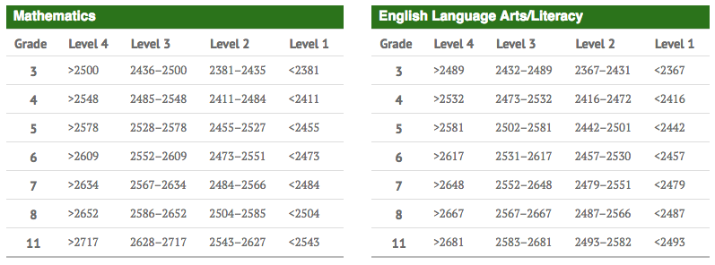
Scaled Score Ranges for Achievement Levels
Session 4.B: Understanding Smarter Balanced Scores
http://www.smarterbalanced.org/assessments/scores/

Slide 19
Scaled Score Ranges for Achievement Levels
Session 4.B: Understanding Smarter Balanced Scores
Center School Grade 5 Cohort
2016 Overall Math Results:
Scale Score – 2495
Level 3
2017 Overall Math Results:
Scale Score – 2516
Level 2

Slide 20
Scaled Score Ranges for Achievement Levels
Session 4.B: Understanding Smarter Balanced Scores
Center School Grade 5 Cohort
2017 Overall Math Results:
Scale Score – 2516
Level 2
Level 2 ALD: achievement standard nearly met

Slide 21
Achievement Level Descriptors (ALDs)
Session 4.B: Understanding Smarter Balanced Scores
Reflect the knowledge, skills, and abilities (KSAs) that students are expected to possess at each achievement level
Connect back to the standards
Help educators build context and meaning around score results
ALDs can be found at: http://www.smarterbalanced.org/assessments/scores

Slide 22
Types of ALDs
Session 4.B: Understanding Smarter Balanced Scores
ALD Type | Intended Use | Purpose
Policy | Test development | Set tone for the rigor of performance standards expected
Range | Item writing | Define content range and limits; cover the whole range of student performance within a level
Threshold | Cut-score recommendation and standard-setting guidance | Define the minimum performance required for meeting a particular achievement-level expectation; are cumulative
Reporting | Test-score interpretation | Describe the knowledge, skills, and processes that students demonstrate, and indicate the knowledge and skills that must be developed to attain the next level of achievement
https://portal.smarterbalanced.org/library/en/elaliteracy-alds-and-college-content-readiness-policy.pdf

Slide 23
Reporting ALDs – Handout 4.1
Session 4.B: Understanding Smarter Balanced Scores
Describe students’ overall achievement for the ELA/literacy and mathematics summative assessments
Banded by grade span (3 to 5, 6 to 8, high school)
Provide a snapshot of whether a student has exceeded, met, nearly met, or not met knowledge and skill requirements for a content area
https://portal.smarterbalanced.org/library/en/elaliteracy-alds-and-college-content-readiness-policy.pdf

Slide 24
Questions about Smarter Balanced scores and score interpretations?
Session 4.B: Understanding Smarter Balanced Scores

Slide 25
Session 4.C: Rightful Place and Rightful Purpose of Summative Assessment

Slide 26
Session 4.C Objectives
Session 4.C: Rightful Place and Rightful Purpose of Summative Assessment
Participants will:
Have a clear understanding of where summative assessments sit within a balanced assessment system
Be able to identify appropriate and inappropriate uses of summative assessment data

Slide 27
Review of Major Assessment Types:
Session 4.C: Rightful Place and Rightful Purpose of Summative Assessment
Center on Standards & Assessment Implementation

Slide 28
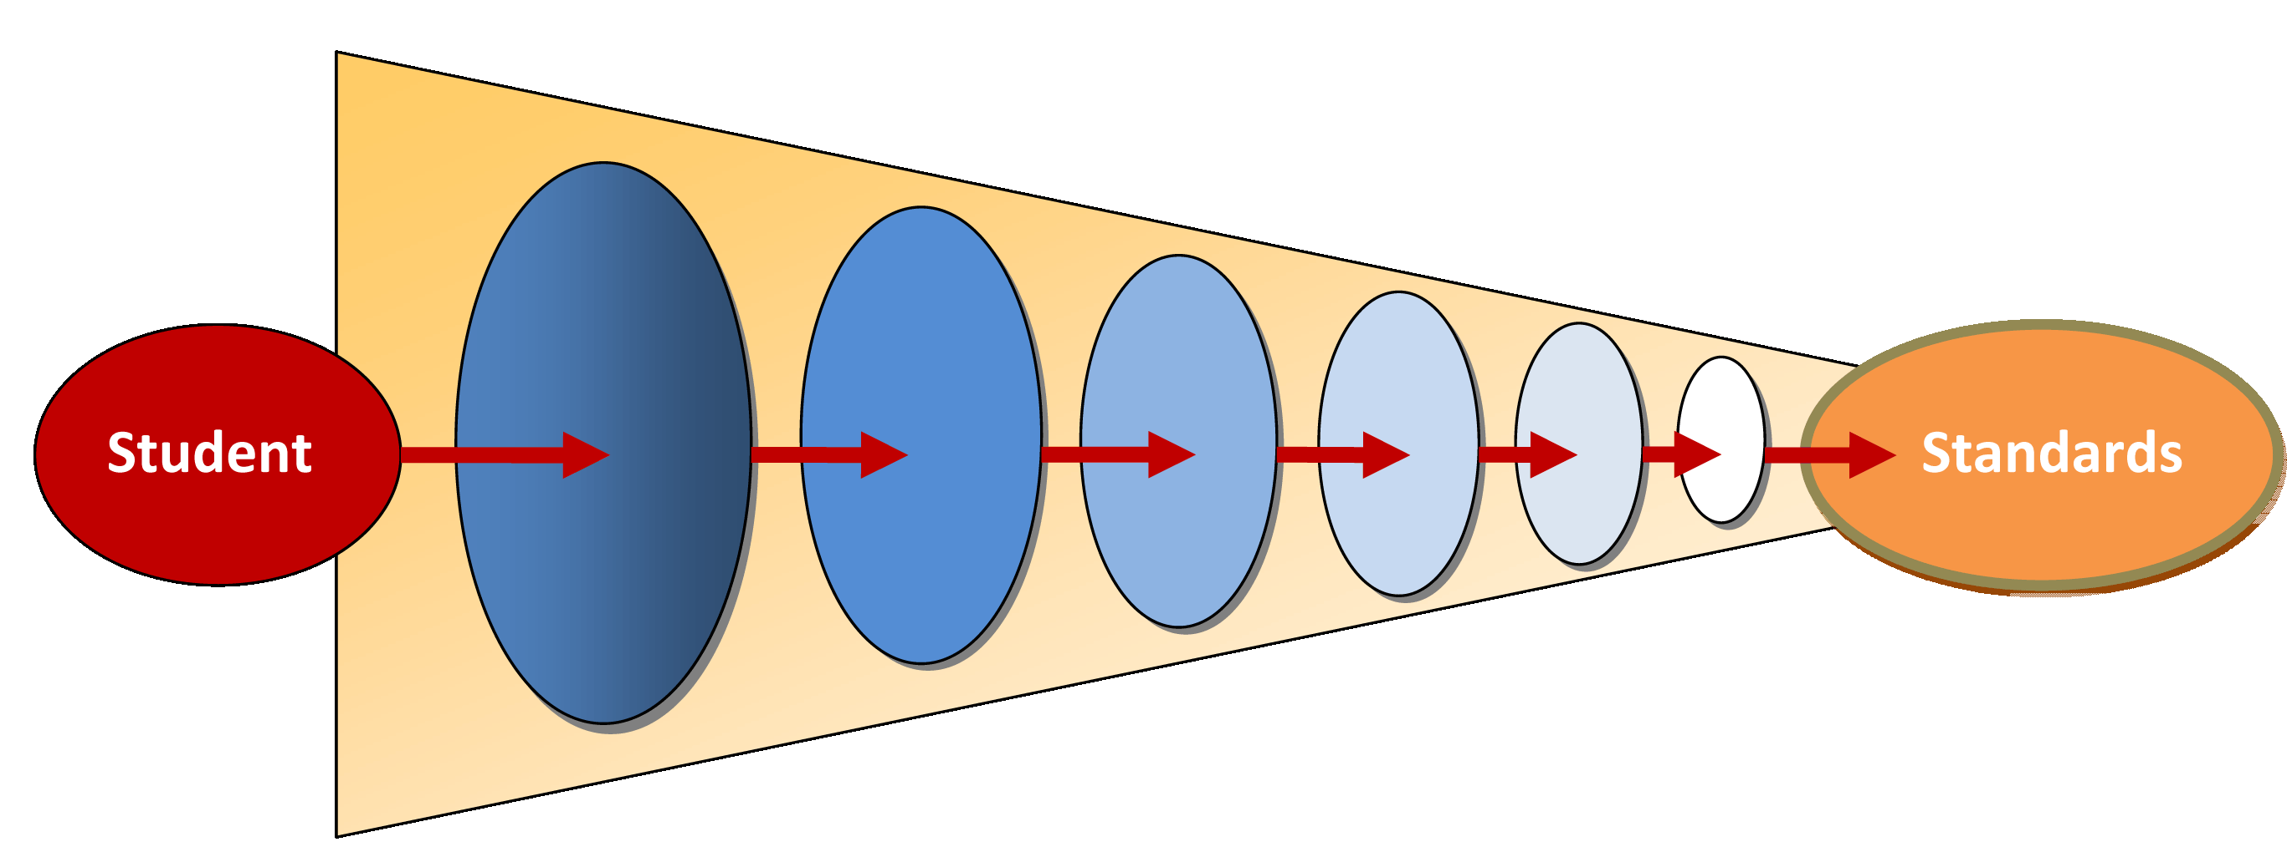
Continuum of Assessment
Session 4.C: Rightful Place and Rightful Purpose of Summative Assessment
Grain size of standards being assessed
Statewide Summative
Classroom
Formative
Immediacy of actionable information

Slide 29
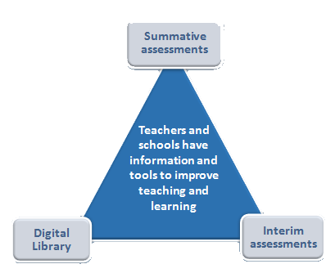
The Role of Summative Assessments in the Smarter Balanced System
Session 4.C: Rightful Place and Rightful Purpose of Summative Assessment

Slide 30
How Do You Use Summative Assessment Data?
Session 4.C: Rightful Place and Rightful Purpose of Summative Assessment
These tests are connected to what is taught in the classroom.
Talk to your elbow partner:
Consider how you currently use summative results to inform teaching and learning.

Slide 31
Using Summative Assessment Data
Session 4.C: Rightful Place and Rightful Purpose of Summative Assessment
 | APPROPRIATE USES OF DATA | INAPPROPRIATE USES OF DATA
CLASSROOM SUMMATIVE ASSESSMENTS
END-OF-YEAR SUMMATIVE ASSESSMENTS
Handout 4.2

Slide 32
Uses of Summative Assessment Data
Session 4.C: Rightful Place and Rightful Purpose of Summative Assessment
Share your ideas:
What appropriate uses of summative data did you identify?
What inappropriate uses did you discuss?
What questions do you have?

Slide 33
Summative Assessment Data
Session 4.C: Rightful Place and Rightful Purpose of Summative Assessment
Can provide a general direction, but we must dig deeper to determine cause
Focus on groups, programs, and disaggregation
Rarely provide definitive answers
Can provide an entry point into collaborative, honest conversation

Slide 34
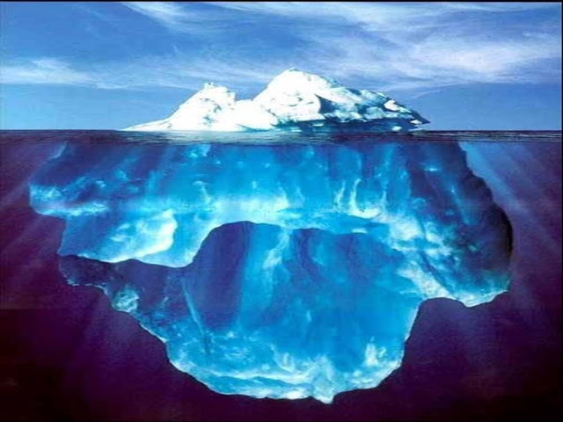
Summative Assessments Are Like Icebergs
Session 4.C: Rightful Place and Rightful Purpose of Summative Assessment

Slide 35
Appropriate Uses of Summative Assessment Data
Session 4.C: Rightful Place and Rightful Purpose of Summative Assessment
Focus on:
Improving learning
Student groups
Engaging in collaborative process with colleagues
Not just about the numbers

Slide 36
Session 4.D: Leveraging Summative Assessment Data to Inform Teaching and Learning

Slide 37
Session 4.D Objectives
Session 4.D: Leveraging Summative Assessment Data to Inform Teaching and Learning
Participants will:
Undertake a replicable data discovery process.
Learn how summative assessment results can be used in their contexts to inform teaching and learning.
Consider the benefits of utilizing summative assessment results within a balanced assessment system.

Slide 38
Summative Data Mini Case Studies
Session 4.D: Leveraging Summative Assessment Data to Inform Teaching and Learning
Locate Handout 4.3.
Use sample data scenarios.
Individually analyze and answer questions as specifically as is possible.
Think about your own context.

Slide 39
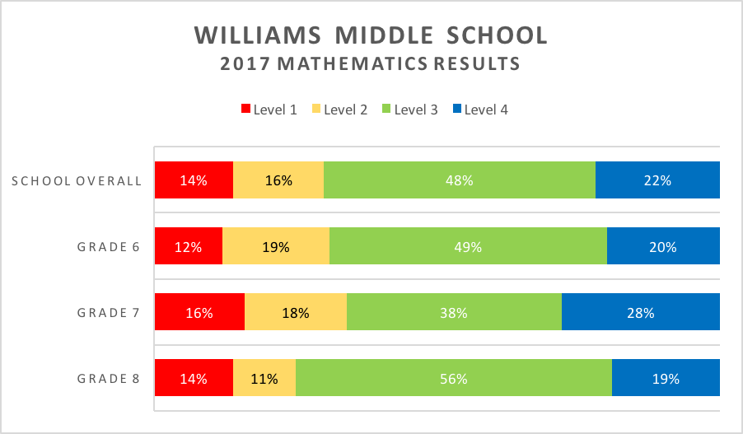
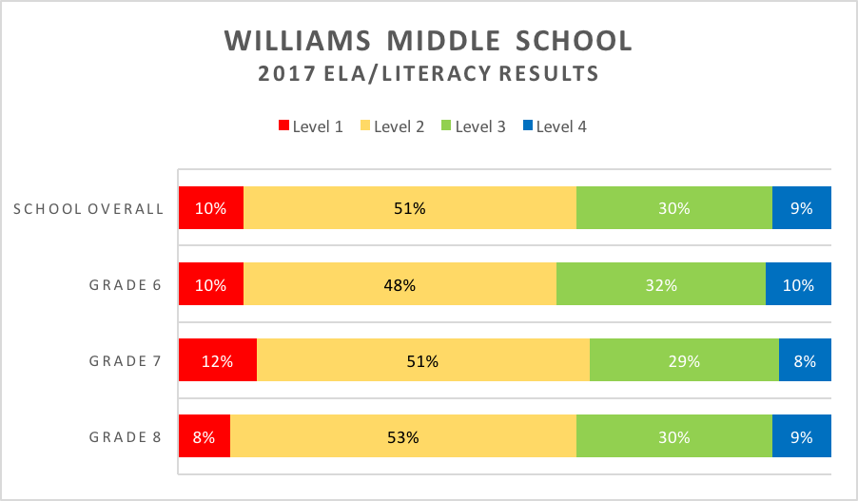
Scenario A: Results by Grade for a School
Session 4.D: Leveraging Summative Assessment Data to Inform Teaching and Learning

Slide 40
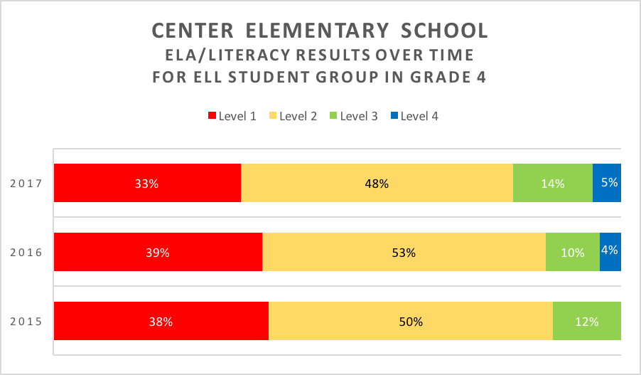
Scenario B: Results for a Student Group Over Time
Session 4.D: Leveraging Summative Assessment Data to Inform Teaching and Learning

Slide 41
Consider Your Analyses
Session 4.D: Leveraging Summative Assessment Data to Inform Teaching and Learning
How do the types of data you are analyzing inform
The conclusions you are able to draw?
Your understanding of data limitations?
The follow-up questions you ask?

Slide 42
Data Analysis Process Template
Session 4.D: Leveraging Summative Assessment Data to Inform Teaching and Learning
DATA SOURCE | RESEARCH | RECALL | REFLECT | RESPOND
Identify and use appropriate data sources. | Using the data sources available, report the facts. Look for trends or areas of concern. Look for areas of success. This is an objective data discovery. . | Focusing on the prior school year(s), discuss the realities of the classroom, school/district programs, practices, and policies. What happened? Focus on facts only—no conjecture. | Connect performance with prior practices, programs, and policies. Consider possible reasons. Be honest about what occurred and how that may have impacted the performance that you observe. | What might be some possible ways to move forward? These responses should tie directly to what emerged from the reflection process.
RESOURCES
Data Review and Discovery
Possible Actions Moving Forward
Programs, Practices, Policies
Possible Connections

Slide 43
Research
Session 4.D: Leveraging Summative Assessment Data to Inform Teaching and Learning
RESEARCH
Using the data sources available, report the facts. Look for trends or areas of concern. Look for areas of success. This is an objective data discovery.
Engage with the data to find facts.
Describe what you observe.
Focus on facts, not conjecture.

Slide 44
Recall
Session 4.D: Leveraging Summative Assessment Data to Inform Teaching and Learning
RECALL
Focusing on the prior school year(s), discuss the realities of the classroom, school/district programs, practices, and policies. What happened? Focus on facts only—no conjecture.
Consider school/classroom programs, practices, and policies.
Think about last year:
What happened?
What curriculum was in place?
What professional learning occurred?

Slide 45
Reflect
Session 4.D: Leveraging Summative Assessment Data to Inform Teaching and Learning
REFLECT
Connect performance with prior practices, programs, and policies. Consider possible reasons. Be honest about what occurred and how that may have impacted the performance that you observe.
Determine possible reasons for the performance.
Keep the conversation honest.
Explore many possibilities.

Slide 46
Respond
Session 4.D: Leveraging Summative Assessment Data to Inform Teaching and Learning
RESPOND
What might be some possible ways to move forward? These responses should tie directly to what emerged from the reflection process.
Think about what you can control.
Ask yourself:
How will you know progress is being made?
What other data are available to you?
Who else needs to be brought in to the conversation?

Slide 47
Put on Your Teacher/Admin./Coach Hat
Session 4.D: Leveraging Summative Assessment Data to Inform Teaching and Learning
Locate Handout 4.4, Data Analysis Process Template.
In your table groups, use the data analysis template to leverage the data from Scenario C in Handout 4.3 to impact teaching and learning.
Draw from your knowledge of ALDs and ECD when crafting your response.
Be prepared to share with the larger group.

Slide 48
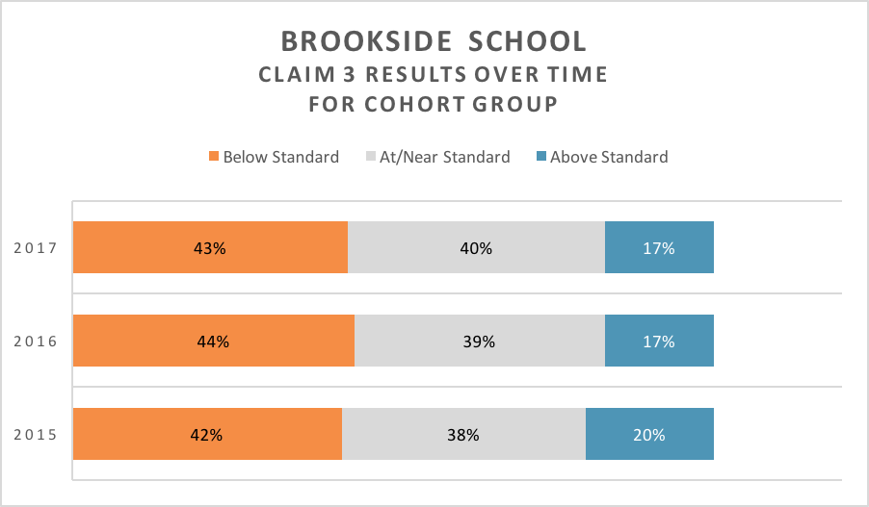
Results by Claim for Cohort Over Time
Session 4.D: Leveraging Summative Assessment Data to Inform Teaching and Learning

Slide 49
Discuss and Write
Session 4.D: Leveraging Summative Assessment Data to Inform Teaching and Learning
What have you learned from this process?
How can you use this process in your own school contexts?
How would you transfer this process to analyze other types of summative data you have access to?

Slide 50
Session 4.E: Wrap-Up

Slide 51
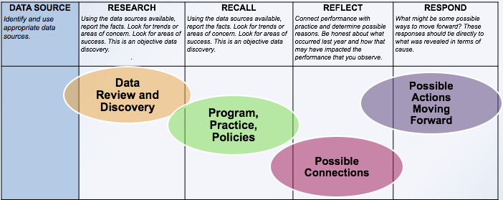
Session 4.E: Wrap-Up
Statewide Summative
Classroom
Formative

Slide 52
Reflection
Session 4.E: Wrap-Up
How will you utilize the resources and processes discussed here back at your site in your contexts (ALDs? ECD?)?
In which collaborative settings at your site can you imagine having these conversations around summative data?
How can these discussions impact teaching and learning?
Discuss with an elbow partner.

